Slide 1

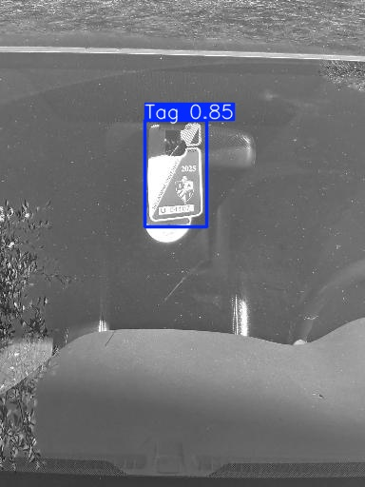
Tag Detection
Chris Myhre, Josh Henderson & Tristan Hibbard
CS-440-01
November 12, 2025

Slide 2
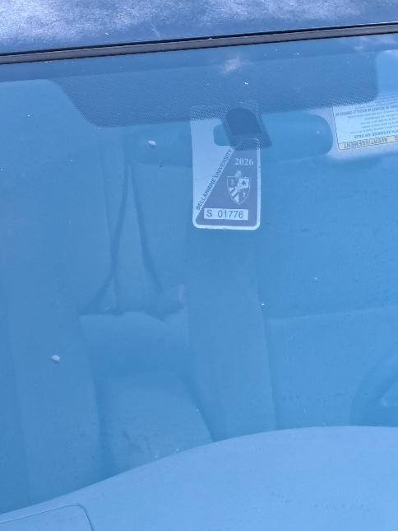

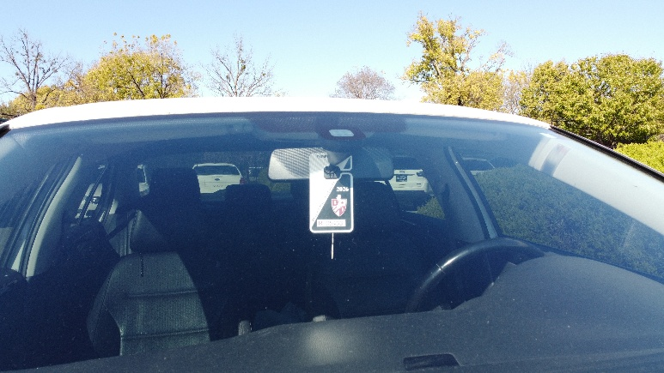
Motivation & Problem Statement
Why: To ensure people park where they're supposed to
Use Cases:
  Smart City Surveillance
  Access Control
  Public Safety

Slide 3

Project Objectives
Accurately detect the presence of parking passes
Capture a variety of car tags from different angles
Create a model that could be used for automated tag detection

Slide 4
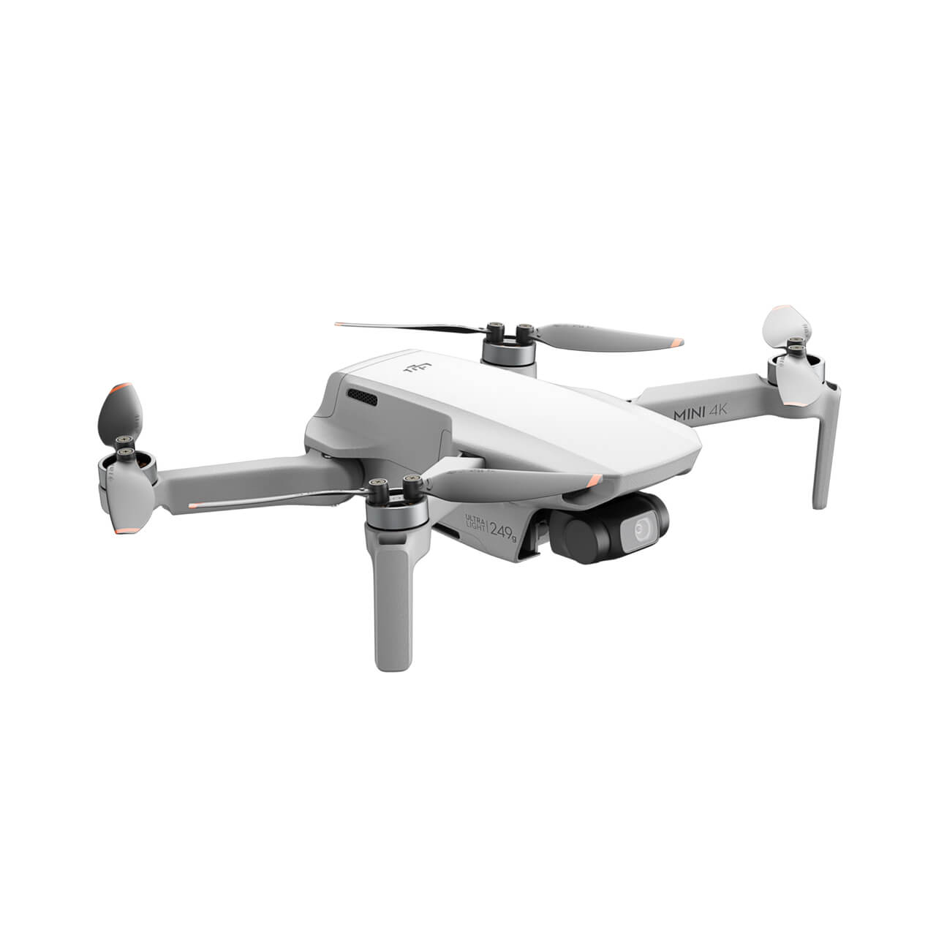
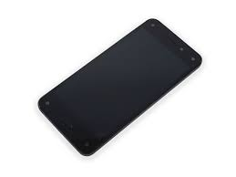
Data Collection
Phone Images: 152
Drone Images: 50
Photo Conditions:
  Variety of angles
  Variety of parking pass obstructions
  Variety of brightness of images
Challenges
  Window reflections
  Sun blockage

Slide 5

Annotation Process
Roboflow annotation service
Upload Images
Split the photos amongst team members to annotate
Annotate and add to dataset
Export dataset

Slide 6



YOLOv11 Training Setup
Preprocessing Steps
  Auto-Orient
  Resize to 512 x 512
  Grayscale
Augmentation Steps
  Blur
  Exposure
Training Steps
  Epochs: 50
  Batch: 16
  Imgsz: 640

Slide 7
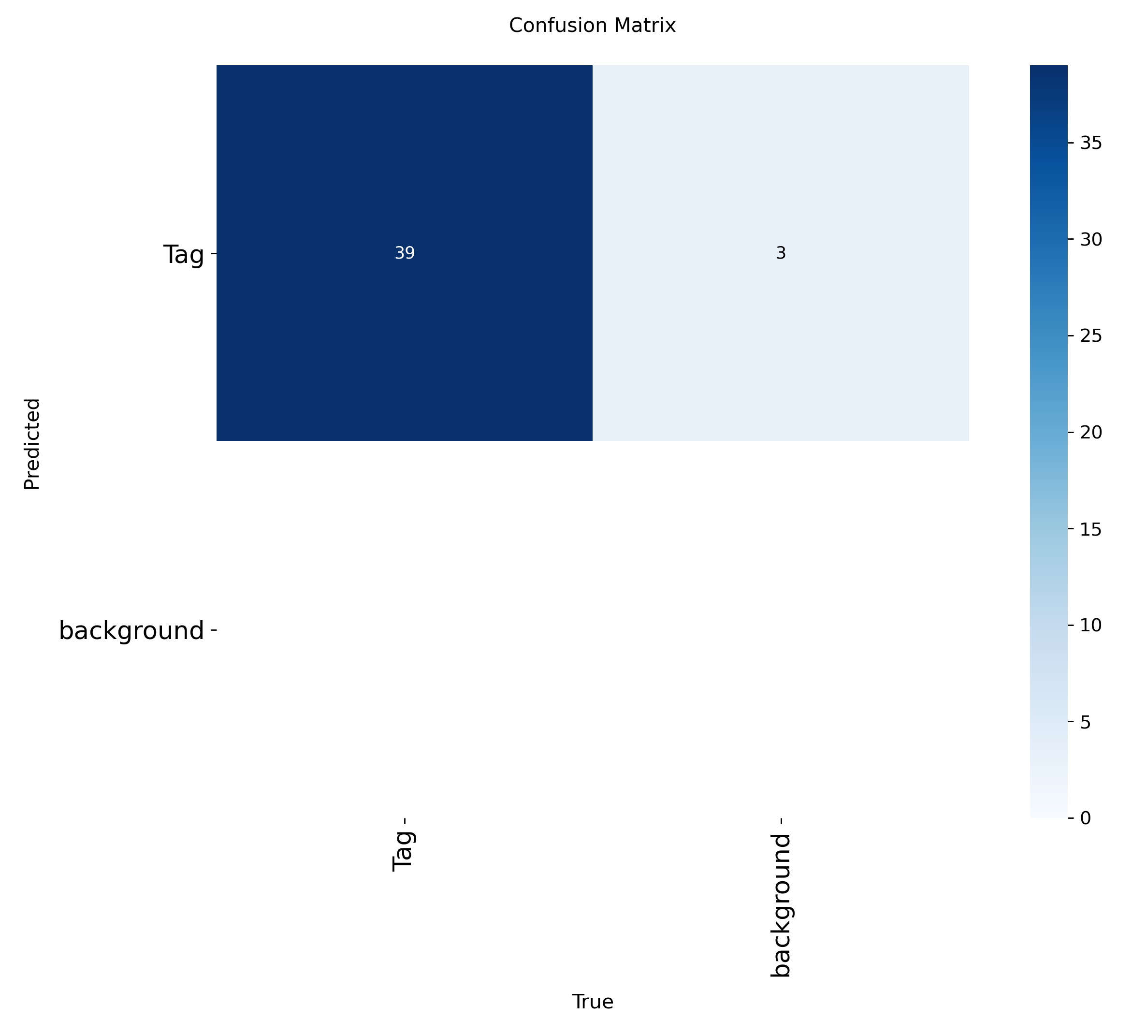
Results & Metrics
Mean Precision (mP): 0.970
Mean Recall (mP): 0.949
mAP @ 0.5: 0.971
mAP @ 0.5:0.95: 0.686

Slide 8
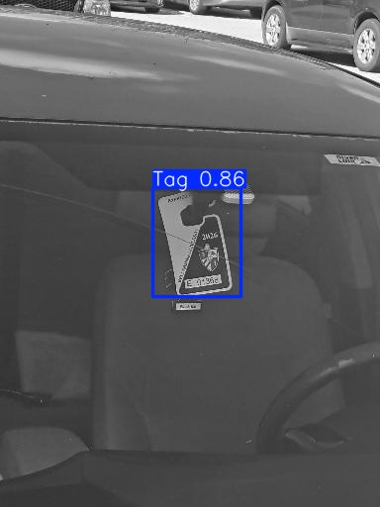
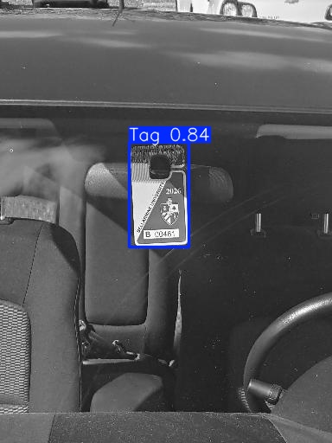
Visualizations of Predictions

Slide 9

Error Analysis
Potential Reasons for Error
  Photos taken at one time of day
  Photos taken primary on a sunny day
  Tags didn't take up more of the photo
  Glare
  Window reflections

Slide 10

Future Improvements
Move camera closer to parking pass
Take photos at a variety of times of day
Take photos in a variety of weather conditions
Experiment more with photo modifications in Roboflow
Take more photos

Slide 11


Conclusions & Takeaways
Model Accuracy: 0.970
Take photos in more of a variety of conditions
Experiment more with Roboflow filters on photos
Take more photos
Overall, good performance

